Slide 1

Apache Kafka
Dima Ionut Daniel

Slide 2
Contents
What is Kafka?
History
Features
Architecture
Core
Producers
Consumers
Conclussion
Bibliography

Slide 3

What is Kafka?
Apache Kafka is an open-source message broker project developed by the Apache Software Foundation written in Scala.
Kafka has a modern cluster-centric design that offers strong durability and fault-tolerance guarantees.
Kafka is designed to allow a single cluster to serve as the central data backbone for a large organization.

Slide 4
History
Apache Kafka was originally developed by LinkedIn, and was subsequently open sourced in early 2011.
Graduation from the Apache Incubator occurred on 23 October 2012.
In November 2014, several engineers who built Kafka at LinkedIn created a new company named Confluent with a focus on Kafka.

Slide 5
Features
Persistent messaging: messages are persisted on disk as well as replicated within the cluster to prevent data loss.
High throughput: Kafka is designed to work on commodity hardware to handle hundreds of MB reads/writers per second.
Distributed: Kafka is cluster-centric design explicitly supports message partitioning over Kafka servers.
Multiple client support: easy integration with different platforms like Java, .NET, PHP, Ruby and Python.
Real time: messages produced by the producer threads should be immediately visible to consumer threads.

Slide 6
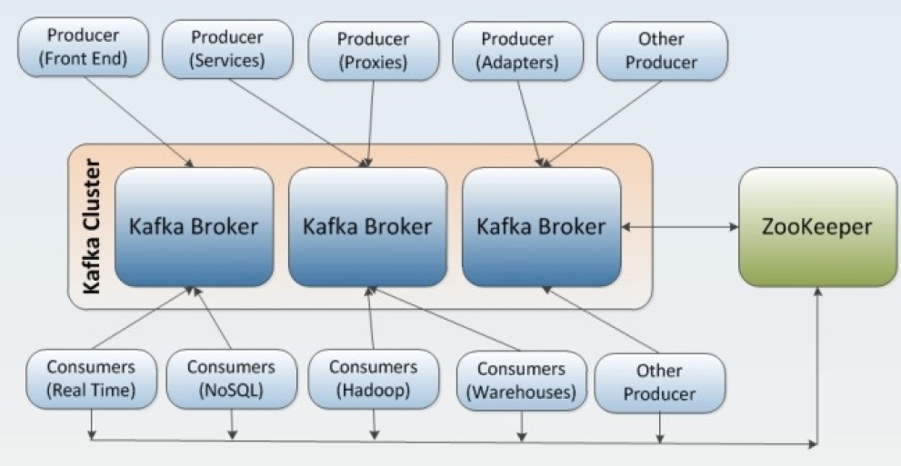
Architecture
Kafka supports also parallel data loading in the Hadoop systems.

Slide 7
Core
Message publishing is a mechanism for connecting various applications.
Kafka is a solution to real-time problems that provides seamless integration between information from producers and consumers.
Apache Kafka aims to unify offline and online processing by providing a mechanism for parallel load in Hadoop systems as well as the ability to partition real-time consumption over a cluster of machines.

Slide 8
Core (cont.)
Typical Kafka use cases:
Log aggregation: collecting log files from servers and put them in a central place (a file server or HDFS) for processing.
Stream processing: Kafka can be used for collecting data.
Commit logs: Kafka can be used to represent external commit logs for any large scale distributed system. Replicated logs over Kafka cluster help failed nodes to recover their states.
Click stream tracking: Kafka can capture use click stream data such as page views, searches, real-time publish-subscribe feeds.
Messaging: Message brokers are used for decoupling data processing from data producers. Kafka can replace many popular message brokers as it offers better throughput, built-in partitioning, replication and fault-tolerance.

Slide 9
Core (cont.)
Kafka is implemented Scala and uses build tool Gradle to build Kafka binaries.
Gradle is a build automation tool for Scala, Groovy and Java projects that requires Java 1.7 or higher.
With Kafka we can create multiple types of clusters:
single node, single broker cluster
single node, multiple broker clusters
multiple nodes, multiple broker clusters.

Slide 10
Core (cont.)
A Kafka cluster primarily has 5 main components:
Topic:
here messages are published by producers.
In Kafka, topics are partitioned and each partition is represented by ordered immutable sequence of messages.
each message in the partition is assigned a unique sequential ID called "offset".
Broker
consists of one or more servers.
topics are created within the context of broker processes.

Slide 11
Core (cont.)
Zookeeper:
coordinates the broker and the consumers.
allows distributed processes to coordinate with each other.
Producers:
publish data to the topics by choosing the appropriate partition within the topic.
Consumer:
processes the data that subs.cribe to topics

Slide 12
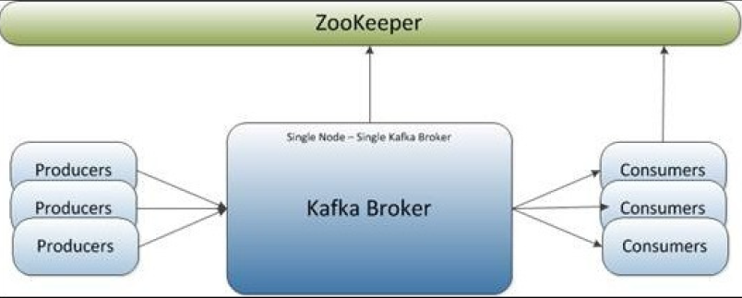
Core (cont.)
A simple setup for Kafka is single node, single Kafka Broker.

Slide 13
Core (cont.)
Kafka provides the default Zookeeper configuraiton file to launch a single local ZooKeeper instance.
bin/zookeeper-server-start.sh config/zookeeper.properties
In order to start the Kafka broker we need to execute:
bin/kafka-server-start.sh config/server.properties
The Zookeeper listens on port 2181 for incoming clients.
The Kafka Broker listens on port 9092.

Slide 14
Core (cont.)
Kafka provides a command line utility to create topics on the Kafka server.
bin/kafka-topics.sh --create --zookeeper localhost:2181 --replication-factor 1 --partitions 1 --topic kafkatopic
To obtain the list of topics on any Kafka server we use the command:
bin/kafka-topics.sh --list --zookeeper localhost:2181
The decision about how a message is partitioned is taken by the producer and the broker stores the messages in the same order as they arrive.
The number of partitions can be configured for each topic within the Kafka broker.

Slide 15
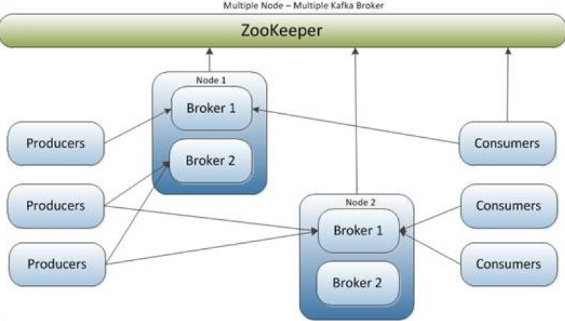
Core (cont.)
We can have multiple brokers configured on multiple nodes and the producers and consumers are connected in different combinations

Slide 16
Core (cont.)
Kafka broker property list
broker.id: non-negative integer ID.
log.dirs: directories in which the log data is stored.
zookeeper.connect: ZooKeeper connection string in hostname:port/chroot form like localhost:2181.
host.name: hostname of the broker.
num.partitions: default number of partitions per topic.
auto.create.topics.enable: enables auto-creation of the topic on the server.
default.replication.factor: default replication factory for automatically created topics.

Slide 17
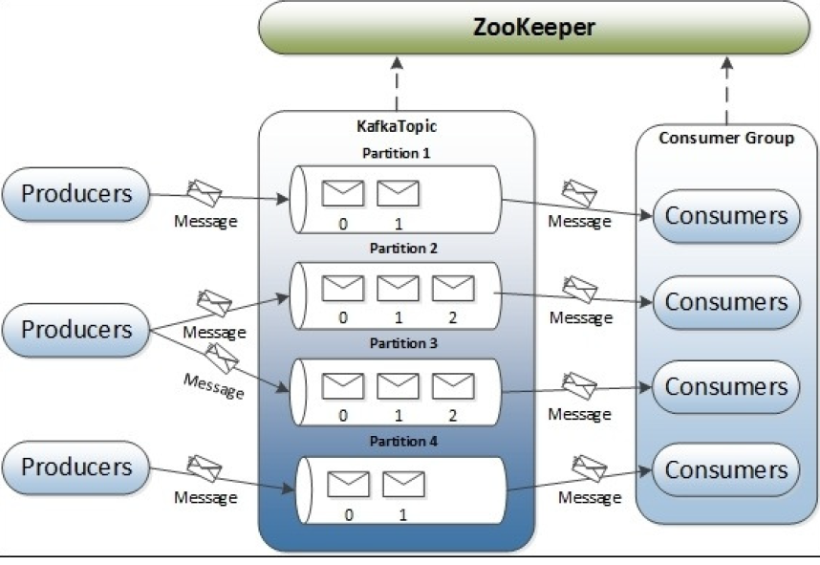
Core (cont.)
In Kafka topics, every partition is mapped to a logical log file that is represented as a set of segment files of equal sizes.

Slide 18
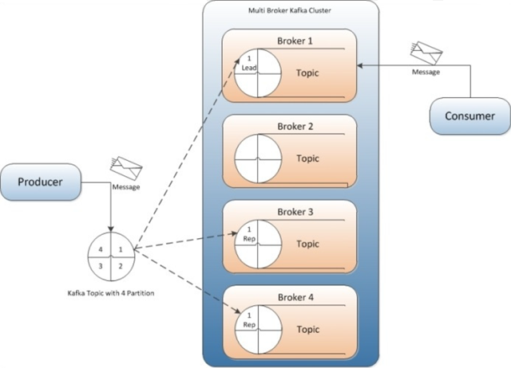
Core (cont.)
Kafka replication is a very important feature.

Slide 19
Core (cont.)
In replication each partition of a message has n replicas and can afford n-1 failures to guarantee message delivery.
Out of the n replicas, one replica acts as the lead replica for the rest of the replicas.
Kafka supports following replication modes: synchronous and asynchronous replication.

Slide 20
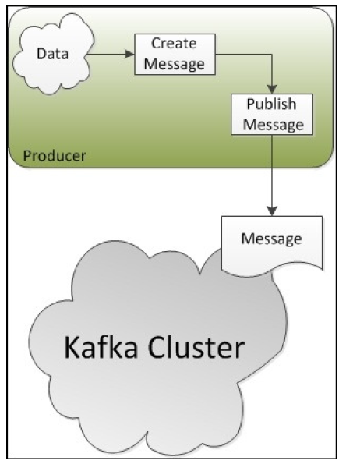
Producers
Producers are applications that create messages and publish them to the Kafka broker.

Slide 21
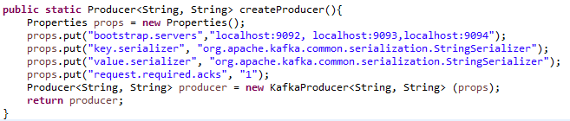
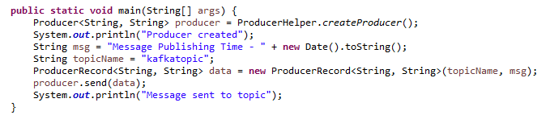
Producers (cont.)
Bellow is a sample of using Producers in Kafka.

Slide 22
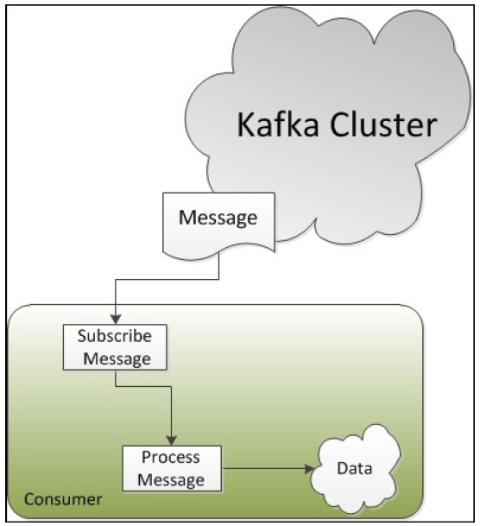
Consumers
Consumers are applications that consume the messages published by producers.

Slide 23
Consumers (cont.)
Kafka provides 2 types of API for Java consumers: high-level and low-level.
The high-level consumer API is used when only data is needed and the handling of message offsets it not required.
The API hides broker details from the consumers and allows effortless communication with Kafka cluster.
The low-level consumer API is stateless and provides fine grained control over the communication between Kafka broker and the consumer.
It allows consumers to set the message offset with every request raised to the broker and maintains the metadata at the consumer's end.

Slide 24
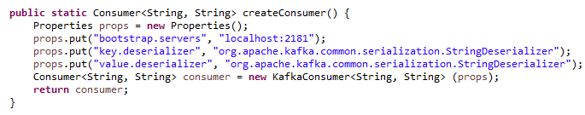
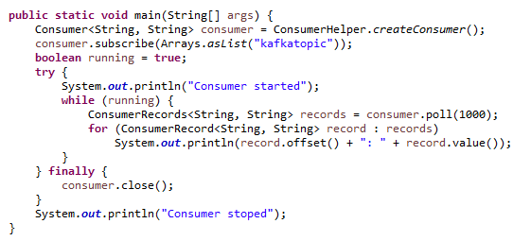
Consumers (cont.)
To begin consumption we need to subscribe to the topic.

Slide 25
Conclussion
PROS
Simple to setup
Uses Kafka's produce and consumer API
Replication feature
CONS:
Hard to monitor

Slide 26

Bibliography
http://kafka.apache.org/
https://en.wikipedia.org/wiki/Apache_Kafka
PacktPub - Learning Apache Kafka, 2nd Edition

Slide 27
Questions ?

